Slide 1


ADRIT
UCLM
ATTRACTION, DEVELOPMENT AND RETENTION OF INTERNATIONAL
TALENT
STUDY AT UCLM

Slide 2

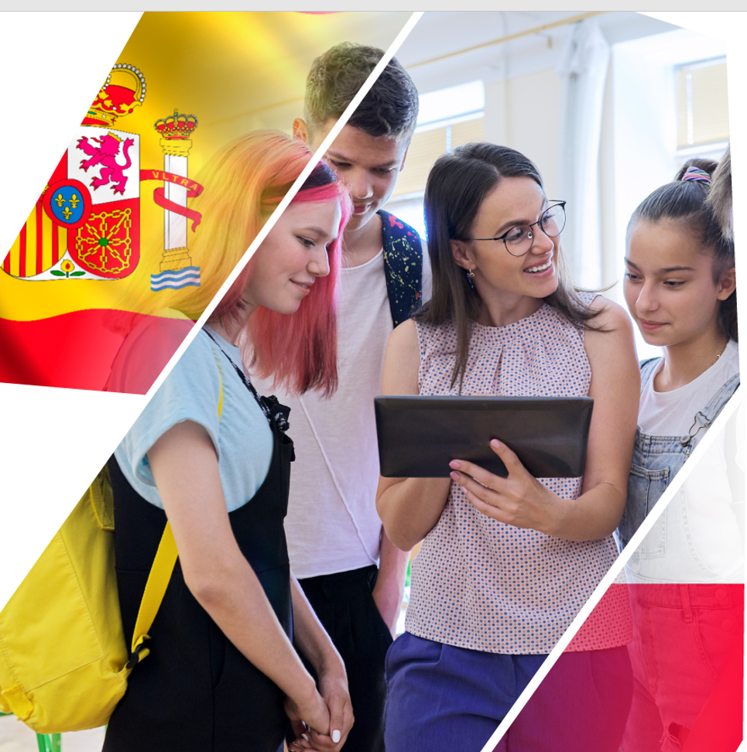
SPANISH BILINGUAL
SECTIONS STUDENTS
10
FREE
ENROLMENT
THE FIRST YEAR OF UNDERGRADUATE STUDIES
ADRIT
UCLM
GRANT
2.000€ EXPENSES (FOOD AND ACCOMODATION)
DISCOUNT
IN HALLS OF RESIDENCE *
STUDY AT UCLM
Notes:
International Talent attraction, developtment & retention

Slide 3
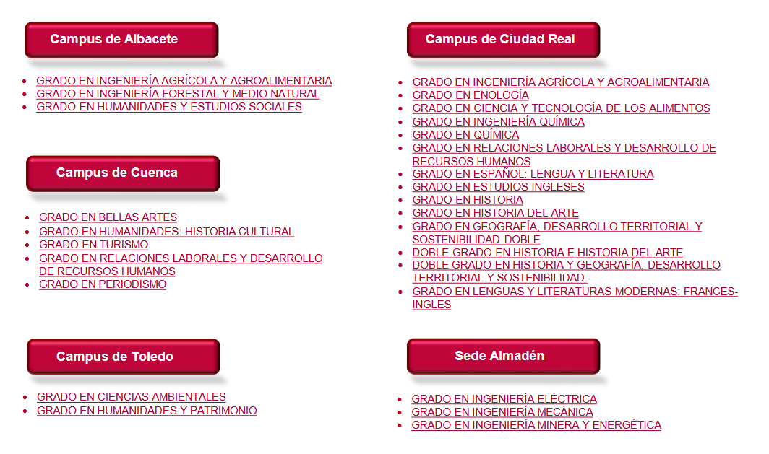
DIRECT ENROLMENT STUDIES 2025/26
DIRECT
ENROLMENT
STUDY AT UCLM

Slide 4





CATEGORY | ESTIMATE COST
ENROLMENT | 800 – 1.200€
SHARED FLAT | ~ 250€/month
HALLS OF RESIDENCE | ~ 550€/month
ADRIT
UCLM
STUDY AT UCLM

Slide 5





NECESSARY DOCUMENTS
Application form
Copy of passport or applicant’s identification document
Completed Bachillerato academic transcript
Language certificates
Recommendation letter, motivation letter and Curriculum Vitae
Register all these documents in the Education Office
or Attaché’s Office of the Spanish embassy in your country
SELECTION CRITERIA
Academic transcript (5 p)
Languages (3 p)
Other merits (2 p)
ADRIT
UCLM
MARCH-MAY
JUNE/JULY
AUGUST
SEPTEMBER
STUDY AT UCLM

